Slide 1


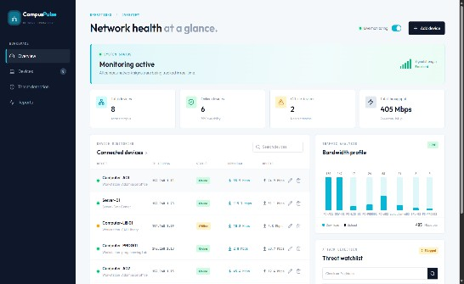
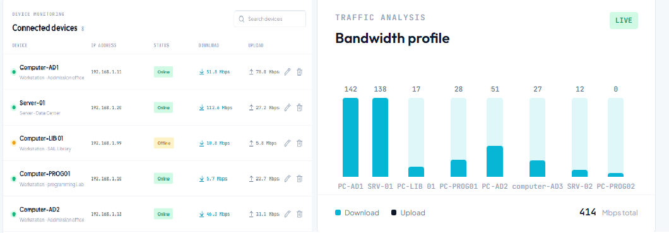
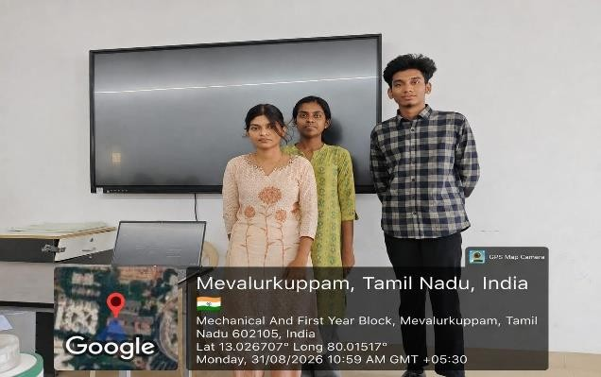
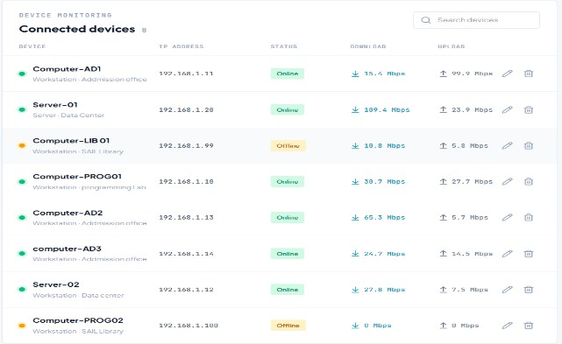
SIMATS ENGINEERING
Saveetha Institute of Medical and Technical Sciences
Chennai- 602105
Student Name: Shylesh Kumar .S Course Code: CSA0704
Course Name: COMPUTER NETWORKS
Reg. No.: 1925260085
Slot:A
Course Faculty: Dr.K. JAI SHARMA
Project Title: SMART CAMPUS NETWORK HEALTH MONITARING DASHBOARD
MODULE PHOTO INDIVIDUAL CONTRIBUTION PRESENTATION IMAGE MODULE WORK IN PROJECT
PROJECT DESCRIPTION: DEVICE MONITARING My work focuses on monitoring the health, connectivity, status and performances of network devices across the campus. It tracks device status, response time and availability to quickly identify network issues and improve overall network performance. It helps identify offline or slow devices and provides timely information for troubleshooting. This improves the reliability and overall performance of the campus network.
Student Signature
Guide Signature

